Slide 1

SDM INSTITUTE OF TECHNOLOGY
DEPARTMENT OF ARTIFICIAL INTELLIGENCE &DATA SCIENCE ENGINEERING
“SMART remote control system in agriculture field using iot”
Under the guidance of
Mr. Amith KS
Professor
Department of ADE
SDMIT, Ujire
Presented By : Presented On :19/12/24
Darshan B M(4SU22AD009) Team No.:16
Deekishith(4SU22AD010)
Jeevan J(4SU22AD018)
Prajwal(4SU22AD035)

Slide 2
INTRODUCTION
Agriculture plays a vital role in sustaining economies and livelihoods. The project, Smart Remote Control System in Agriculture Field using IoT, aims to modernize farming practices by introducing a smart system that allows farmers to monitor and control agricultural equipment and conditions remotely. By integrating IoT technology, the project uses an ESP32 microcontroller, sensors, Firebase cloud storage, and a web-based interface for seamless operation and data management.

Slide 3
Problem Statement
Challenges in Traditional Farming:
Manual monitoring of fields is time-consuming and labor-intensive.
Inefficient use of resources such as water, electricity, and fertilizers.
Lack of remote management for controlling field operations.
Limited ability to adapt to unpredictable challenges like droughts, pests, and soil degradation.
Need for Innovative Solutions:
Integration of technology to modernize farming practices.
Systems to optimize resource usage and improve crop productivity.

Slide 4
System Implementation
Cloud Integration:
Firebase used for real-time data storage.
Web interface:
A website built using HTML, CSS, and JavaScript for visualizing sensor data.
Testing and Validation:
Unit testing of sensors and ESP32 functionality.
Hardware Setup:
Sensors (e.g., soil moisture, Voltage level, Water level) connected to the ESP32 microcontroller.

Slide 5
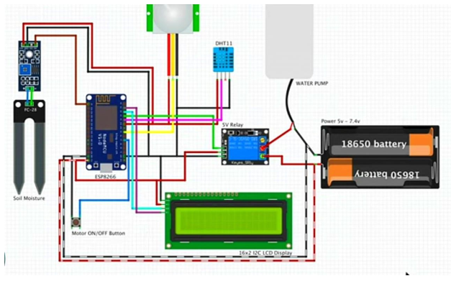

Slide 6
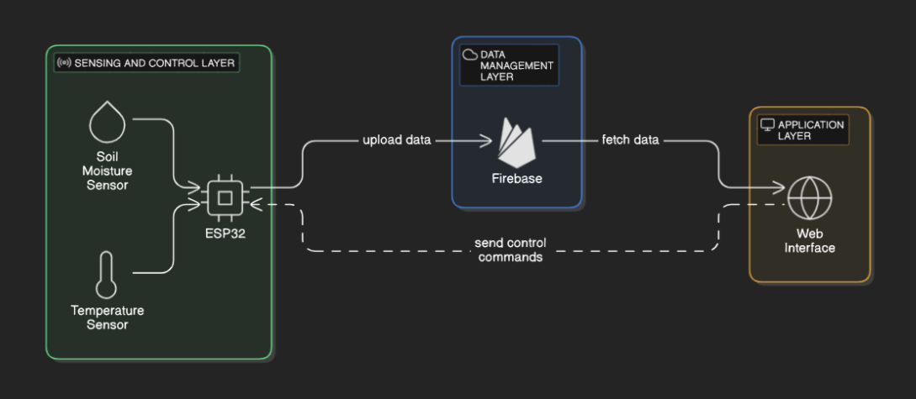
Flow Chart

Slide 7
HARDWARE AND SOFTWARE REQUIREMENTS
Software Requirements:
Tools and Frameworks:
Visual Studio Code
Firebase
Operating Systems: Windows 10/11
Hardware Requirements:
ESP32 Microcontroller: Dual-core, low power.
Sensors: Soil moisture, temperature, and humidity.
Acutators: Relays for irrigation control.

Slide 8
PERFORMANCE ANALYSIS
Data Transmission:
Under strong Wi-Fi signals:Data updates within 1 second.
Under weak Wi-Fi signals:Data updates within 5 second.
Sensor Accuracy:
Soil moisture sensor: ±3% deviation.
Temperature sensor: ±1°C deviation.
System Responsiveness:
Average response time for remote commands: 3 seconds.
Energy Efficiency:
The ESP32 and sensors consume an average of 150 mW during operation.

Slide 9
RESULTS
Real-Time Monitoring:
Continuous collection and display of data (e.g., soil moisture: 45%,voltage: 50v, water level: 10%).
Remote Control:
Farmers can control irrigation pumps remotely via the website.
Alerts and Notifications:
Alerts for conditions like low soil moisture or high temperature.

Slide 10
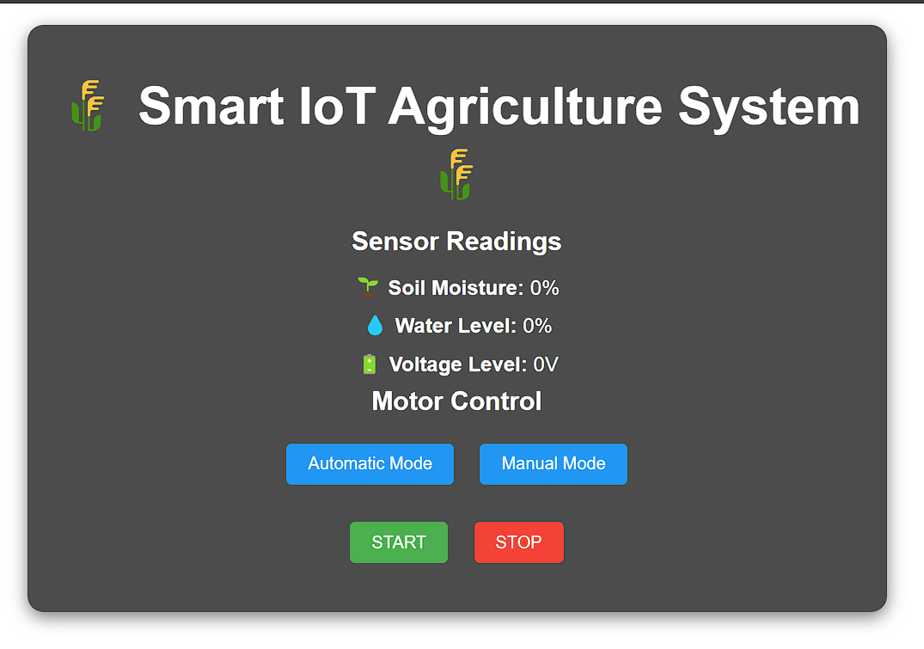
Website

Slide 11
FUTURE ENHANCEMENTS
Mobile Application
Offline Functionality
Additional Sensors
AI and Predictive Analytics
Renewable Energy Integration

Slide 12
SYSTEM TESTING
Verified the functionality of individual components such as the search bar, weather API integration, and forecast display.
Ensured smooth interaction between UI components and the backend services (e.g., weather data retrieval).
Tested the complete system to ensure all features worked cohesively, including location-based weather updates and speech-enabled forecasts.
Inputting valid and invalid location names.
Verifying the accuracy of weather data.
Ensured the app met functional requirements and delivered a seamless user experience.

Slide 13
CONCLUSION
The project successfully demonstrates the potential of IoT in revolutionizing agricultural practices. By providing real-time insights and remote control capabilities, it empowers farmers to optimize resources, reduce manual effort, and improve crop productivity. The proposed future enhancements aim to make the system more robust, versatile, and accessible, paving the way for widespread adoption of IoT in agriculture.

Slide 14
REFERENCES
JOURNALS:
Engineering Science & Technology Journal.
Chandramenon , Amar Aggoun, Fideline Tchuenbou-Magaia Energy and Green Technology Research Group
Websites:
https://developer.mozilla.org/en-US/docs/Web/API/Fetch_API
https://www.w3schools.com/
https://developer.mozilla.org/en-US/docs/Web/API/SpeechSynthesis
YouTube Tutorials:
https://youtu.be/LaUzGdtLFiQ?feature=shared
https://youtu.be/cm-Qe2HMJGk?feature=shared

Slide 15
-:THANK YOU:-

